Slide 1
Intelligent Agents
Chapter 2

Slide 2
Outline
Agents and environments
Rationality
PEAS (Performance measure, Environment, Actuators, Sensors)
Environment types
Agent types

Slide 3
Agents
An agent is anything that can be viewed as perceiving its environment through sensors and acting upon that environment through actuators
Human agent:
Eyes, Ears, and other organs for Sensors;
Hands, Legs, Mouth, and other body parts for Actuators.
Robotic agent:
Cameras and Infrared range finders for Sensors;
Various Motors for Actuators.

Slide 4
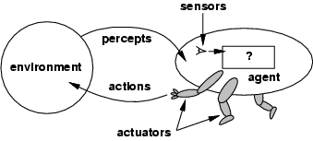
Agents and Environments
The agent function f maps from percept histories P* to actions A :
The agent program runs on the physical architecture to produce A.
agent = architecture + program
[f: P* → A]

Slide 5
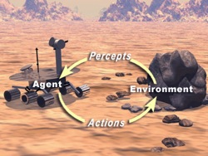

Slide 6

Vacuum-cleaner world
Percepts: location and contents, [A , Dirty]
Actions: Left, Right, Suck, NoOp
Function : (agent keeps Right and Left if both rooms are clean)

Slide 7
Vacuum-cleaner world
Percept | Action
[A, Clean] | Right
[A, Dirty] | Suck
[B, Clean] | Left
[B, Dirty] | Suck
[A, Clean] [B, Clean] | Nop

Slide 8
Rational agents
An agent should strive to "do the right thing", based on what it can perceive and the actions it can perform.
The right action is the one that will cause the agent to be most successful.
EX: Performance measure of a vacuum-cleaner agent:
- amount of dirt cleaned up,
- amount of time taken,
- amount of electricity consumed,
- amount of noise generated, etc.
Performance measure: An objective criterion for success of an agent's behavior.

Slide 9
Rational agents
Rational Agent:
For each possible percept sequence, a rational agent should select an action that is expected to maximize its performance measure, given some built-in knowledge the agent has about the environment.
The performance measure that defines the criterion of success:
– The agent’s percept sequence to data.
– The agent’s prior knowledge of the environment.
– The actions that the agent can perform.

Slide 10
Rational agents
• Is a vacuum-agent rational? (Depends!)
• Performance measure
– amount of dirt cleaned up,
– amount of time taken,
– amount of electricity consumed,
– amount of noise generated, etc..
• A priori
– Geography of the environment is known (two squares, A is on left and B is on right, etc.).
– Perception is trustable (no illusion ).
– Sucking cleans the current square .

Slide 11
Rational agents
Actions
– Left, right, suck.
• Current percept
– [location, dirt]
• Possible extensions
– The agent have partial memory (reasoning percept histories).
– The geography of the environment is unknown.
– The agent cannot percept its current location.
– Agent can learn from experience.

Slide 12
Rational agents
Rationality is distinct from omniscience (all-knowing with infinite knowledge)
An agent is autonomous if its behavior is determined by its own experience (with ability to learn and adapt).
Agents can perform actions in order to modify future percepts so as to obtain useful information (information gathering, exploration).

Slide 13
Specify the setting for intelligent agent design: PEAS Description
PEAS:
P : Performance measure
E : Environment
A : Actuators
S : Sensors
Must first specify the settings for intelligent agent design.

Slide 14
PEAS
EX: Consider the task of designing an automated taxi driver:
(Intelligent Transportation Systems)
Performance measure: Safe, fast, legal, comfortable trip, maximize profits
Environment: Roads, traffic, pedestrians customers.
Actuators: Steering wheel, accelerator, brake, signal, horn.
Sensors: Cameras, sonar, speedometer, GPS, odometer, engine sensors, keyboard.

Slide 15
PEAS
Agent: Medical diagnosis system
Performance measure: Healthy patient, minimize costs & lawsuits
Environment: Patient, hospital, staff.
Sensors: Keyboard (entry of symptoms , findings , patient's answers)
Actuators: Screen display (questions, tests , diagnoses , treatments , referrals )

Slide 16
PEAS
Agent: Interactive English tutor
Performance measure: Maximize student's score on test
Environment: Set of students
Sensors: Keyboard
Actuators: Screen display (exercises, suggestions, corrections)

Slide 17
Agent: Internet shopping agent
Performance measure? price, quality,
appropriateness, efficiency
Environment?? current and future WWW sites,vendors, shippers
Actuators?? display to user, follow URL, fill inform
Sensors?? HTML pages (text, graphics, scripts)

Slide 18
PEAS
Agent: Part-picking robot
Performance measure: Percentage of parts in correct bins
Environment: Conveyor belt with parts, bins
Sensors: Camera, joint angle sensors
Actuators: Jointed arm and hand

Slide 19
Environment types
Discrete / Continuous
Observable / Partially Observable
Static / Dynamic
Single agent / Multiple agents
Accessible / Inaccessible
Deterministic / Non-deterministic
Episodic / Non-episodic

Slide 20
Environment types
Fully observable (vs. partially observable):
An agent's sensors give it access to the complete state of the environment at each point in time.
– Playing chess? Fully.
– Medical diagnosis? Partially.
– Taxi driving? Partially.

Slide 21
Environment types
Deterministic (vs. stochastic) :
The next state of the environment is completely determined by the current state and the action executed by the agent.
– Medical diagnosis? Stochastic.
– Battle field ? Stochastic.
– E-shopping? Deterministic.
– E-auction? Stochastic.
– Playing chess? Strategic .
Strategic : If the environment is deterministic except for the actions of other agents.

Slide 22
Environment types
Episodic (vs. sequential) :
An agent’s action depends only on an “episode” (snapshot) of the environment, i.e. history independent.
– Chess? Sequential.
– Web search? Episodic.

Slide 23
Environment types
Static (vs. dynamic): The environment does not
change over time.
– Playing crossword puzzle? Static.
– Playing soccer? Dynamic.
– Battle field? Dynamic.

Slide 24
Environment types
Discrete (vs. continuous): A limited number of distinct, clearly defined percepts and actions.
– Taxi driving? Continuous
– Playing chess? Discrete.

Slide 25
Environment types
• Single agent (vs. multi-agent):
An agent operating by itself in an environment.
– Crossword puzzle? Single
– Playing chess? Multi
– Taxi driving? Multi

Slide 26
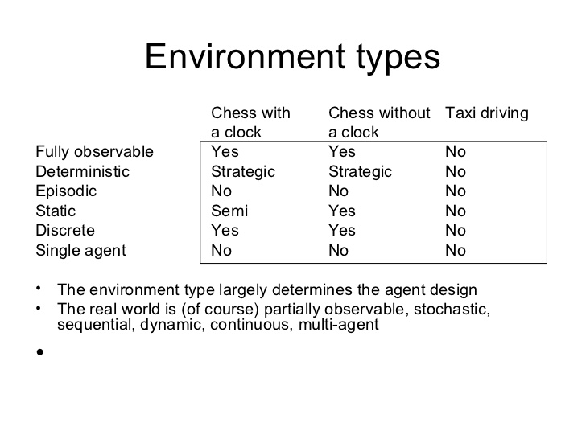

Slide 27
Environment types
Chess with Chess without Taxi driving
a clock a clock
Fully observable Yes Yes No
Deterministic Strategic Strategic No
Episodic No No No
Static Semi Yes No
Discrete Yes Yes No
Single agent No No No
The environment type largely determines the agent design
The real world is (of course) partially observable, stochastic, sequential, dynamic, continuous, multi-agent

Slide 28
Relationship between Agents
• Collaborative vs. Competitive
– Playing chess? Competitive.
– Taxi driving? Cooperative,
• Trustworthy vs. Suspicious
• Same capabilities or different
• Share information or not
• Delegate responsibility or not

Slide 29
Agent functions and programs
An agent is completely specified by the agent function mapping percept sequences to actions
One agent function (or a small equivalence class) is rational
Aim: find a way to implement the rational agent function concisely

Slide 30
Relationship between Agents
• Collaborative vs. Competitive
– Playing chess? Competitive.
– Taxi driving? Cooperative,
• Trustworthy vs. Suspicious
• Same capabilities or different
• Share information or not
• Delegate responsibility or not

Slide 31
Agent types
• Table-lookup agent
– Huge table.
– Take a long time to build the table.
– No autonomy.
– Even with learning, need a long time to learn the table entries.

Slide 32
Agent types
Four basic types in order of increasing generality:
Simple reflex agents
Model-based reflex agents
Goal-based agents
Utility-based agents

Slide 33
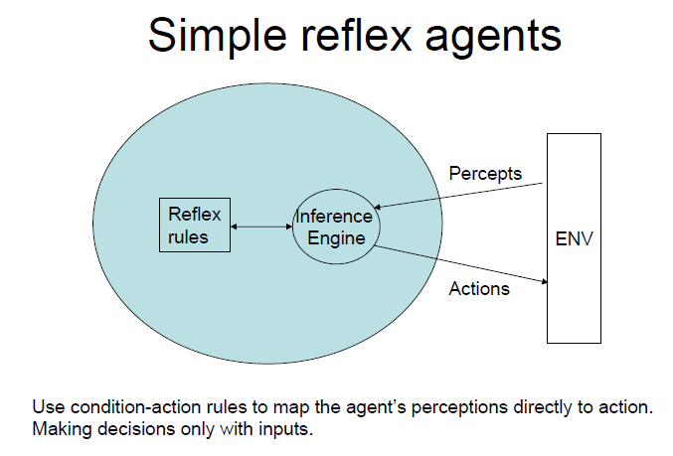

Slide 34
Simple Reflex agent
They choose actions only based on the current percept.
They are rational only if a correct decision is made only on the basis of current precept.
Their environment is completely observable.
Eg. If car-in-front- is breaking
Then initiate breaking

Slide 35
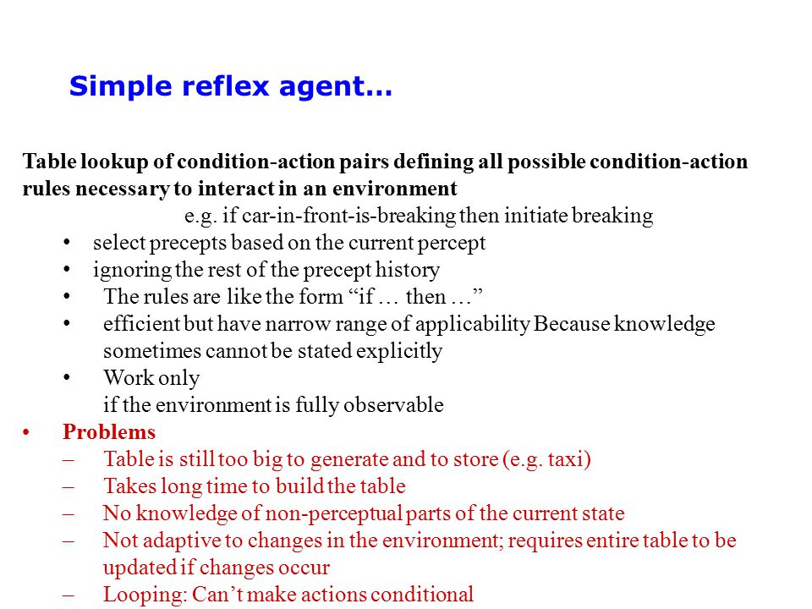

Slide 36
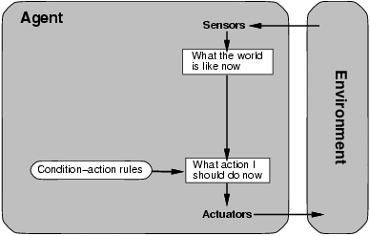
Simple reflex agents

Slide 37
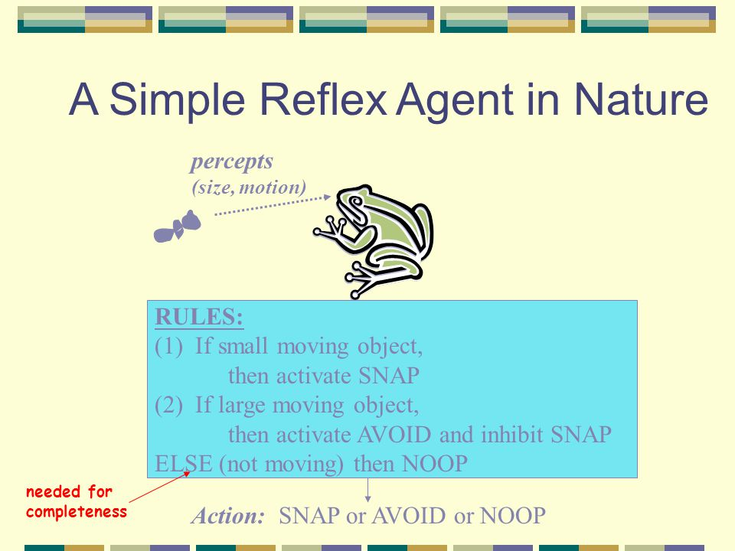

Slide 38
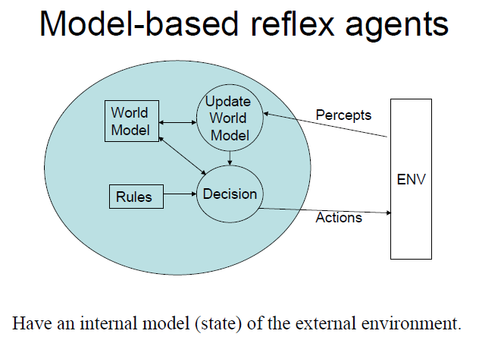

Slide 39
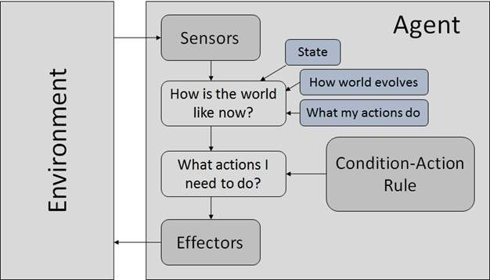

Slide 40
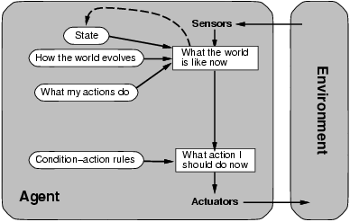
Model-based reflex agents

Slide 41
They use a model of the world to choose their actions. They maintain an internal state.
Model − The knowledge about how the things happen in the world.
Internal State − It is a representation of unobserved aspects of current state depending on percept history.
Updating the state requires the information about −
How the world evolves.
How the agent’s actions affect the world.

Slide 42
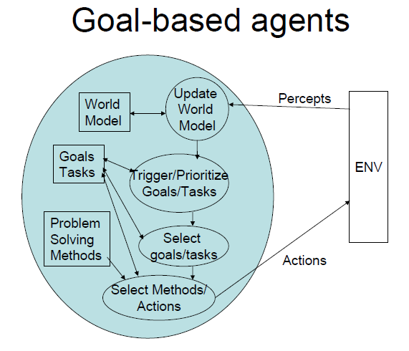

Slide 43
Goal Based Agents
They choose their actions in order to achieve goals.
Goal-based approach is more flexible than reflex agent since the knowledge supporting a decision is explicitly modeled, thereby allowing for modifications.
Goal − It is the description of desirable situations.

Slide 44
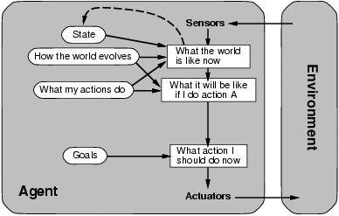
Goal-based agents

Slide 45
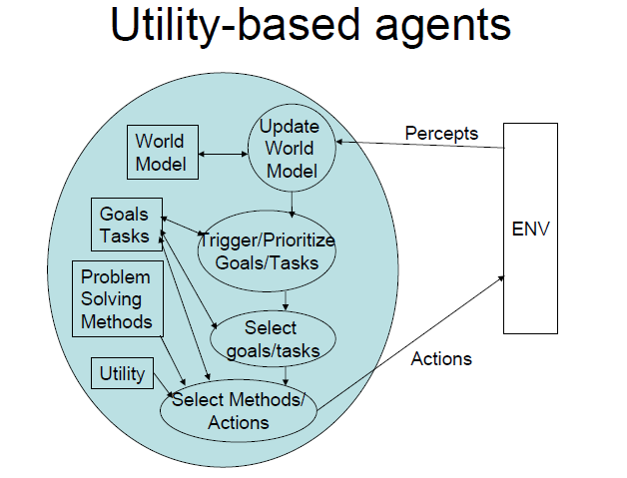

Slide 46
Utility Based Agents
They choose actions based on a preference (utility) for each state. Goals are inadequate when
There are conflicting goals, out of which only few can be achieved.
Goals have some uncertainty of being achieved and you need to weigh likelihood of success against the importance of a goal.

Slide 47
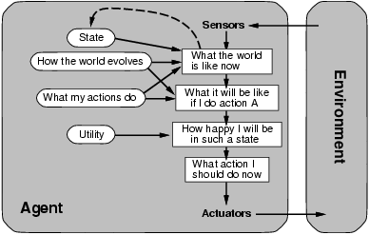
Utility-based agents

Slide 48
Technologies of Software Agents
• Machine learning
• Information retrieval
• Agent communication
• Agent coordination
• Agent negotiation
• Natural language understanding
• Distributed objects

Slide 50
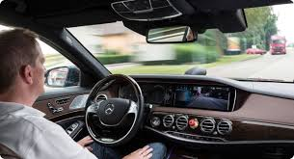

Slide 51
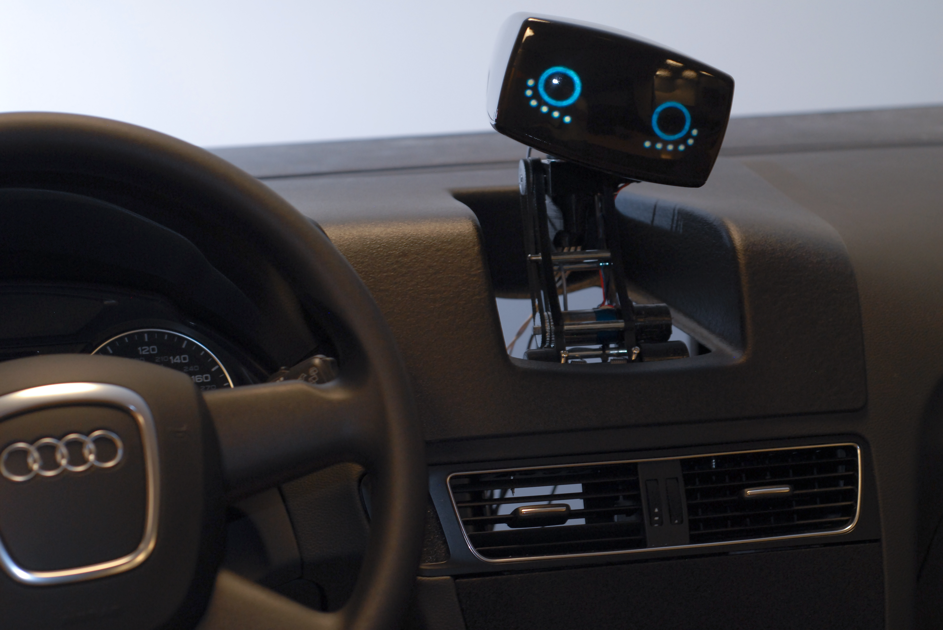

Slide 52
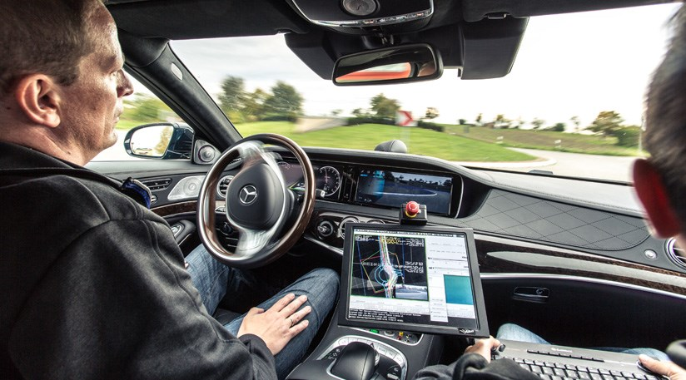

Slide 53
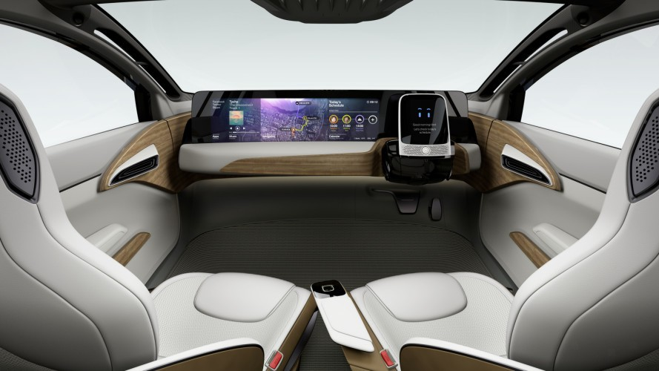

Slide 54
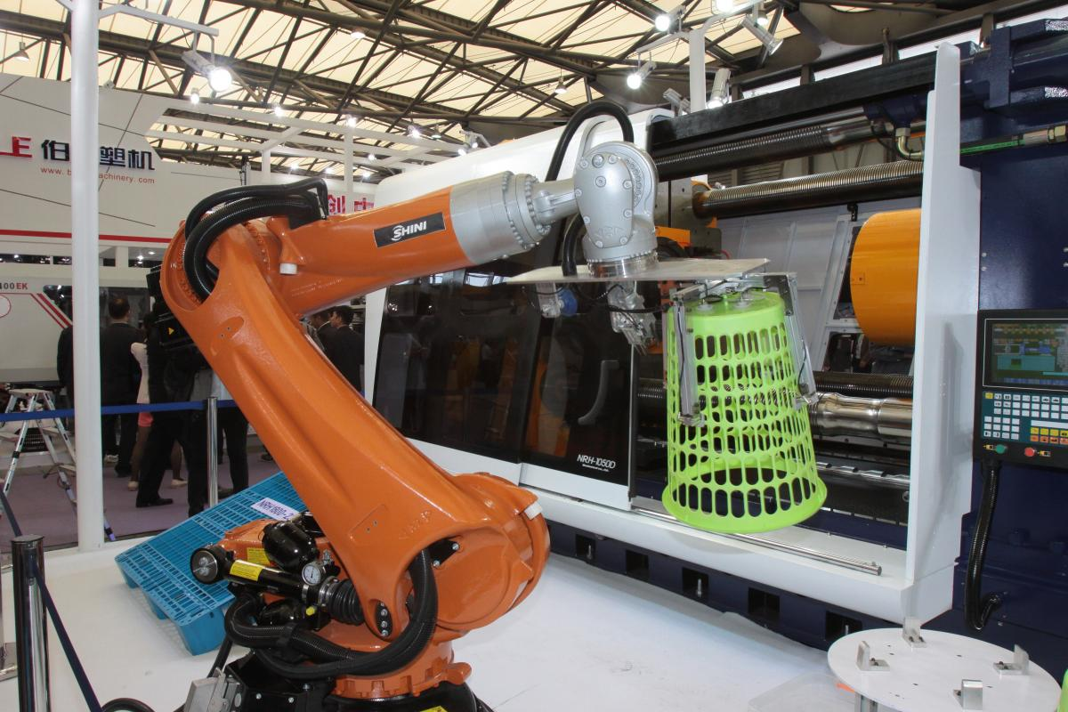

Slide 55
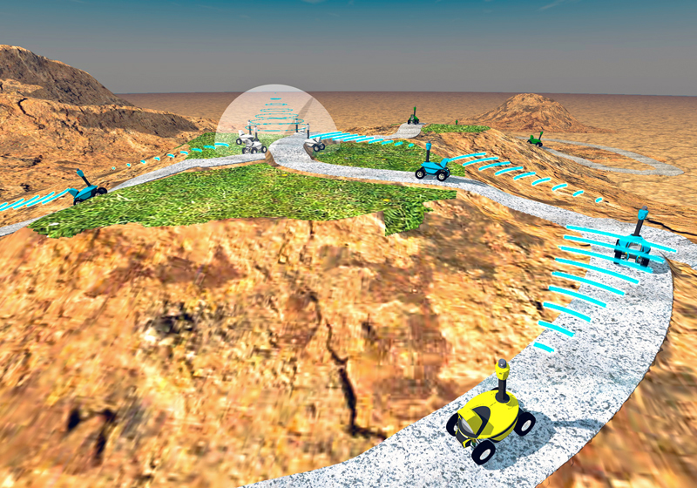
Multi Agent Robotics System

Slide 56
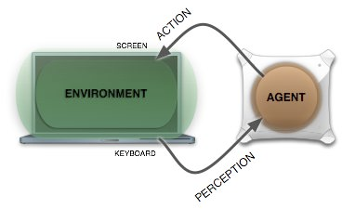

Slide 57
